Slide 1
Acceptance Testing
Leonardo Machado & Renato Ayres

Slide 2
What is it?
Acceptance Testing is a testing technique whose purpose is to determine whether or not a system meets the requirement specifications

Slide 3
1. Contract Acceptance Testing
2. Regulation Acceptance Testing
3. Alpha Testing
4. Beta Testing (User Acceptance Testing)
5. Operational Acceptance Testing (OAT)
1. 2. 3. 4. 5.

Slide 4
Contract Acceptance Testing
Tests if the criteria and specifications of the work developed are compliant with the agreement on the contract
Weflkjnawlkmsvlaer awelkçjdnre dçlkfjtslkm serçli dft seoriujg segnxdofijk gseroigdlfkng slrekng serligkdxfmng soiergn.ldxmfn glçseirng esçrng klçejrhg .kelrq.ng,dmn gaopwie nqpoaiwn fça<lsznef l kjsndflçakjnw eojrfn sdz,fmng çoaeijnr tlgjzsdnm oaçwin4l f çaolw4eenrfçlksd façwoeirijas dlçfa wçer çalw4jker çalswkeqr açweoirj aswçeoirjapwçoiejrlçaksdmn fçoawije fçlsamdjfçalwijmdjf açornvçlaiwerqg asdf-vlkaweçrol1ij sçdfkjawçoiejfçalsidjf açowilejrfçlszdmnf çawliejrf çsldnfmçawliejr smdnfçalwiejky çakswdçnf çowrkjgmdzfbg akwsubf z,ds fkjawhber f

Slide 5
Regulation Acceptance Testing
Tests if the criteria and specifications of the work developed are compliant with governmental or legal regulations

Slide 6
Alpha Beta (UAT)
App
App
REAL
WORLD
Builds up to
App
App
App
App

Slide 7
Alpha Beta (UAT)
Improve quality | Why? | Improve quality, integrate customer input
When the product is a near fully-usable state | When? | Prior to launch
3-5x the beta duration | How long? | Few weeks
Test engineers, employees or close friends and family | Who? | Real potential costumers
Beta Test | Next? | Release

Slide 8
Operational Acceptance Testing (OAT)
Tests the security of the work developed, its maintenance processes and backup plans
Notes:
Make an example on the board of UAT with OAT

Slide 9
Behavioral Driven Development (BDD)
“BDD is a second-generation, outside-in, pull-based, multiple-stakeholder, multiple-scale, high-automation, agile methodology. It describes a cycle of interactions with well-defined outputs, resulting in the delivery of working, tested software that matters.”
- Dan North

Slide 10
How to define an Acceptance Test?
When a User adds 5 to 5 the calculator must return 10.
Given that a Renault Clio’s initial value is 12000€ and when it is resold its value must decrease in at least 60%, the highest value it can be bought after being used is 4800€

Slide 11


Slide 12
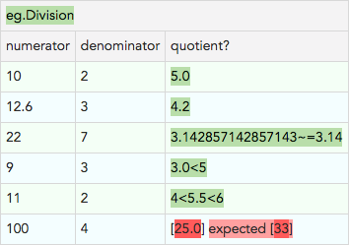
Wiki created in a Java server
Pros
Easy setup
Can work with Excel Spreadsheets
Cons
No natural language support
”Messy” fixture code
Big learning curve

Slide 13
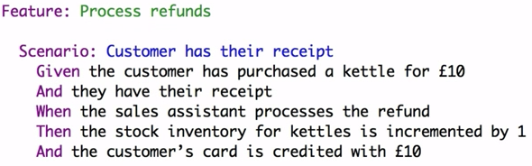
Pros
Natural language support
Instrumentation is directly on the Java code via annotations
Cons
Complex due to Ruby/JRuby/Java chain
Only runnable with Ant or Maven

Slide 14

Pros
Natural language support
JUnit Support
Easy setup
Can be written in Markdown or HTML and Java or C#
Java is Pure Java
Cons
Usually the programmer needs to change the specification to instrument it

Slide 15
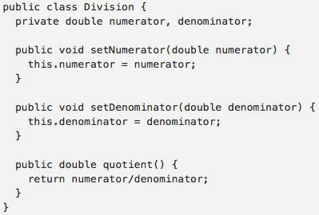
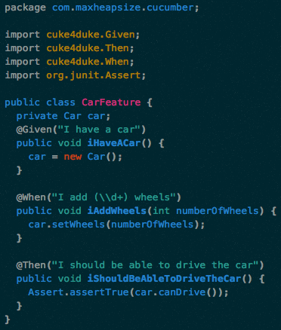
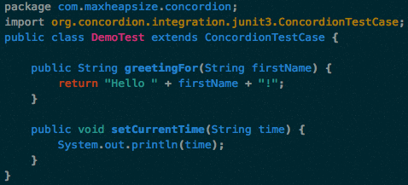

Slide 16
IntelliJ Integration
Easy setup
Eclipse Integration
Spring Integration
Natural Language Support
Jenkins Integration

